Slide 1
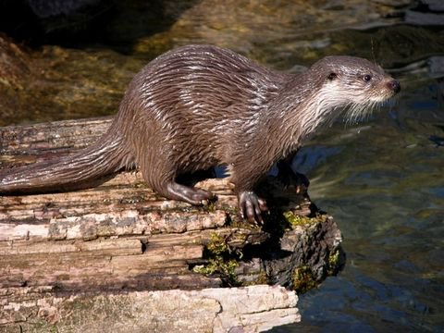
Four major orders of Mammals
There are 19 orders of mammals. Ten of these orders live in North America.
Pictures from Encyclopedia of Life: eol.org
Notes:
Otter

Slide 2
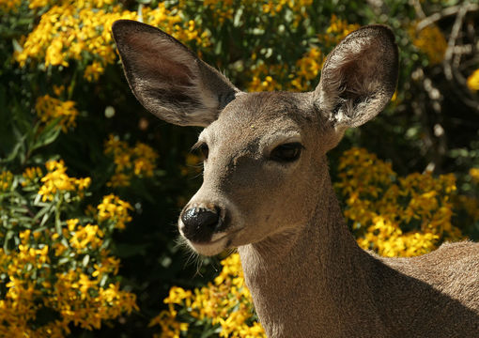
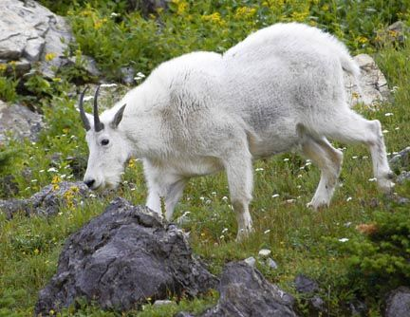
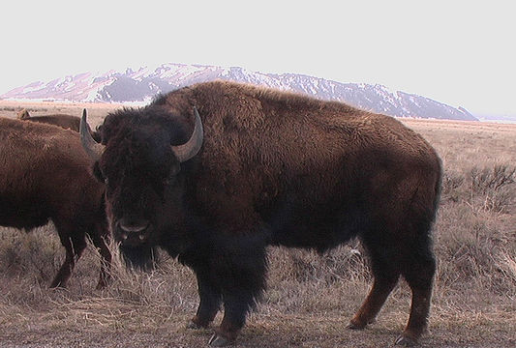
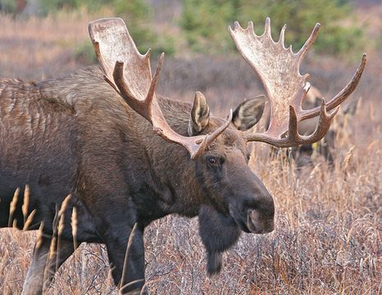
Major Group: Ungulates (Order artiodactyla)
What do these animals have in common?
Notes:
Mule Deer; Mountain Goat; Plains Bison; Moose

Slide 3
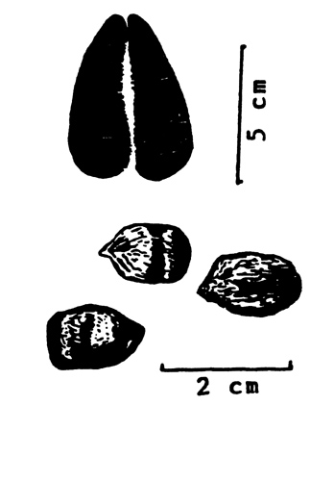
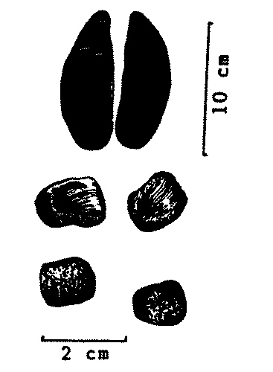
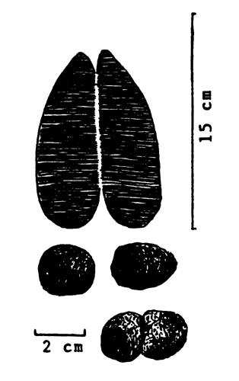
Ungulates are mammals with hooves
A hoof is a modified toenail
Since only the hooves touch the ground, ungulates can run fast
Includes deer, elk, moose, antelope, bison, goats
Deer Tracks and Droppings
Elk Tracks and Droppings
Moose Tracks and Droppings

Slide 4
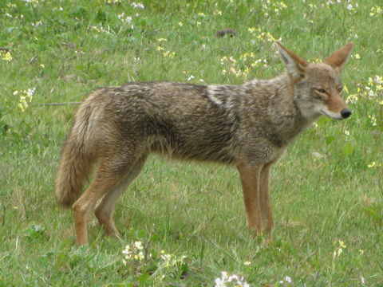
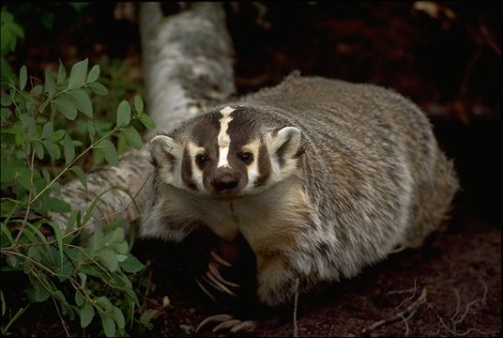
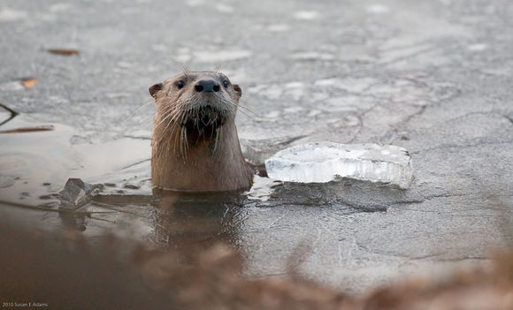
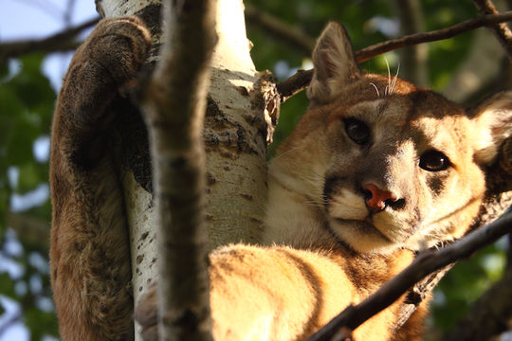
Major Group: Carnivores (Order carnivora)
What do these animals have in common?
Notes:
Coyote; Badger; Northern River Otter; Puma

Slide 5
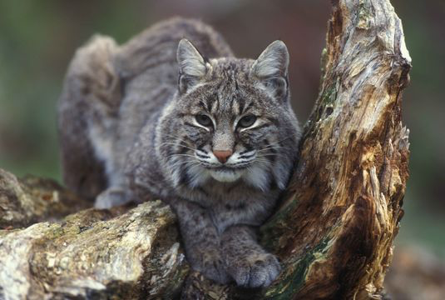
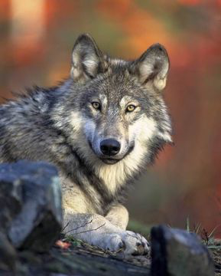
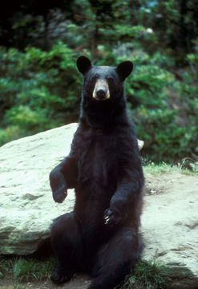
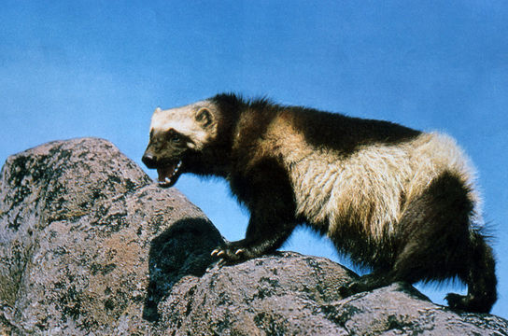
Carnivores – eat other animals
Carnivores are important to keep other animal populations in control
Require a lot of energy (food) to catch other animals
Includes wolves, foxes, bears, raccoons, skunks, otters, cats
Family Felidae
Family Ursidae
Family Mustelidae
Family Canidae
Notes:
Bobcat; Wolverine; Wolf; Black Bear

Slide 6
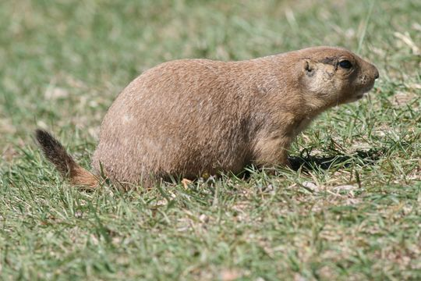
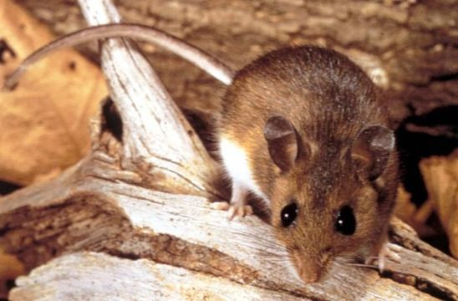
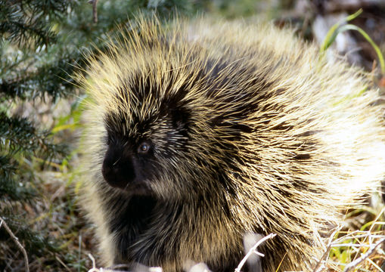
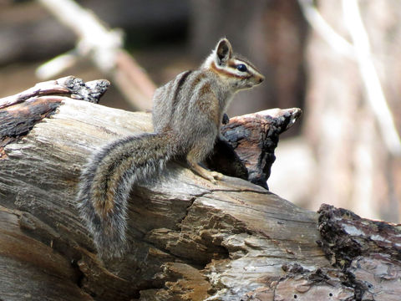
Major Group: Rodents (ORDer rodentia)
What do these animals have in common?
Notes:
Black-tailed Prairie Dog; Deer Mouse; Porcupine; Cliff Chipmunk

Slide 7
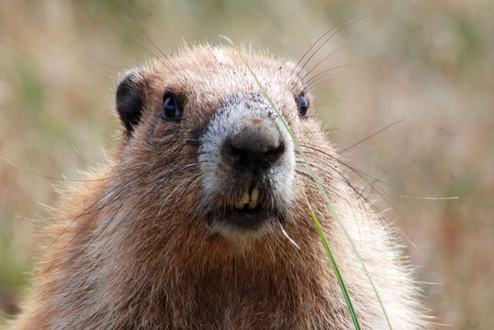
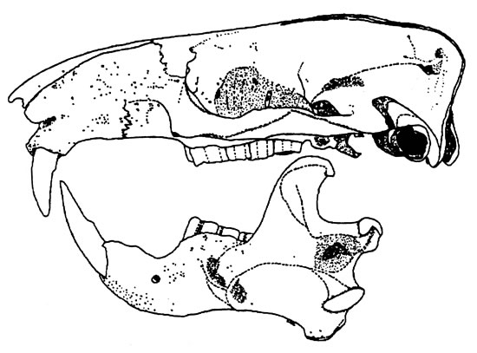
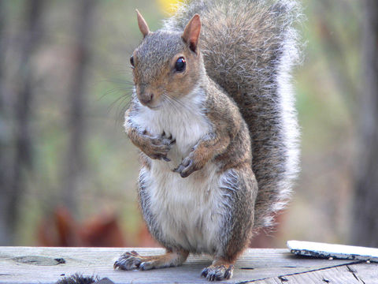
Rodents – single pair of growing teeth in upper and lower jaws
Enamel on teeth is softer on back side. As the animal bites, the backside of the tooth erodes quicker and leaves a sharp point
Their teeth continue to grow—must gnaw to survive
Includes beavers, chipmunks, squirrels, marmots, mice, muskrats, rats, gophers
Notes:
Marmot; Squirrel

Slide 8
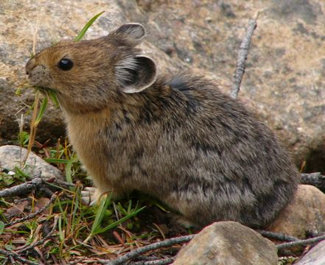
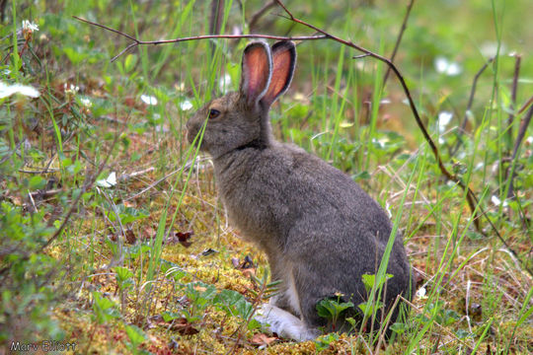
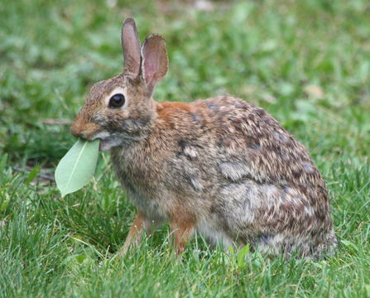
Major Group: Lagomorphs (order lagomropha)
What do these animals have in common?
Notes:
American Pika; Snowshoe Hare; Eastern Cottontail

Slide 9
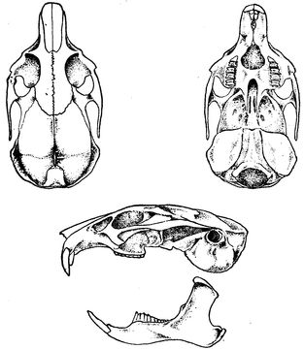
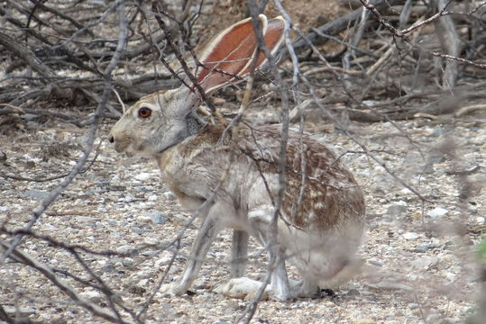
Lagomorphs – strong hind legs
Differ from rodents—have four teeth in upper jaw; need to gnaw because their teeth continue to grow throughout lifetime
Two sets of teeth—second set is often called peg teeth and located behind first set
Includes pikas, hares, and rabbits
Notes:
Jackrabbit; Ochotona Line Drawing

Slide 10
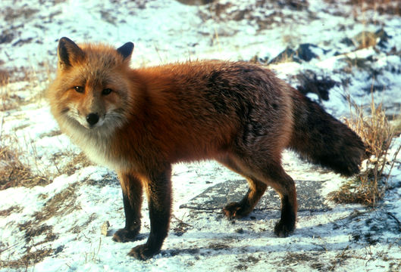
Ungulate, carnivore, rodent, lag0morph??
This mammal is identified by the red upperparts and a bushy tail with a white tip.
Name of Mammal?
What type of food does this mammal eat?
Notes:
Red Fox; Primarily voles—almost anything that is readily available (rabbits, birds, reptiles, etc…)

Slide 11
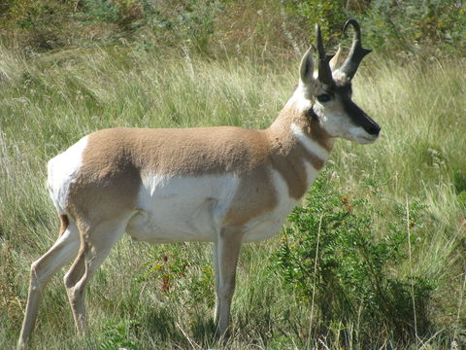
Ungulate, carnivore, rodent, lag0morph??
This mammal is identified by russet-tan colors on its upper side and white on the lower side. Males have stronger black markings on head and throat.
Name of Mammal?
What is the average weight of a buck?
Notes:
Pronghorn; 110-130 pounds

Slide 12
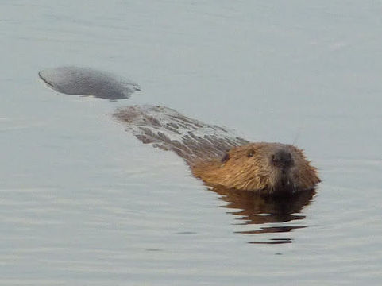
Ungulate, carnivore, rodent, lag0morph??
This mammal is identified by its chunky body, and scaly paddle-shaped tail.
Name of Mammal?
What other two animals are similar?
Notes:
Beaver; River Otter and Muskrat

Slide 13
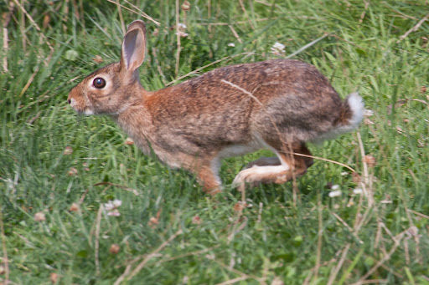
Ungulate, carnivore, rodent, lag0morph??
This mammal is identified by its brownish body, cinnamon on sides, and white powderpuff tail.
Name of Mammal?
When are the young born?
Notes:
Eastern Cottontail; March to September

Slide 14
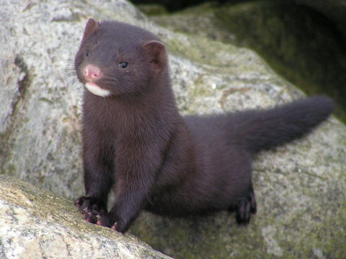
Challenge animal
This mammal is identified by its weasel shape, rich dark brown color, and white chin.
Name of Mammal?
What time of the day do they usually come out and hunt?
Notes:
Mink; Nocturnal

Slide 15
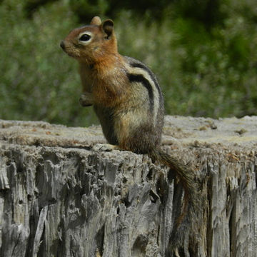
Challenge animal
This mammal is identified by its coppery head and neck, gray back, and stripes down the side (not on face).
Name of mammal?
Do these animals hibernate?
Notes:
Golden-mantled Ground Squirrel; True hibernators from around October until maybe May

Slide 16
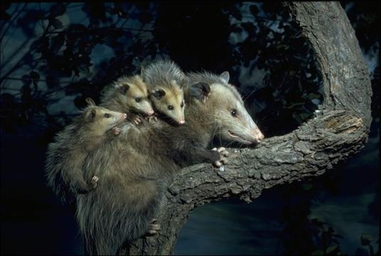
Challenge animal
This mammal is identified by its gray fur, long pointed snout, black ears, and naked scaly tail.
Name of mammal?
Where would you find this mammal during the day?
Notes:
Virginia Opossum; Hollow tree or log, rock cave, or earth den

Slide 17
pictures from Encyclopedia of life: eol.org
Slide 1: Otter: Biopix / Aqua Silkeborg
Slide 2: Mule Deer: Flickr: EOL Images / © Wayne Dumbleton
Mountain Goat: Flickr: EOL Images / © funpics47
Plains Bison: Flickr: EOL Images / © Arthur Chapman
Moose: Wikimedia Commons / Public Domain
Slide 4: Coyote: Wikimedia Commons
Badger: CalPhotos / © 1999 California Academy of Sciences
Northern River Otter: Flickr: EOL Images / © Susan Adams
Puma: CalPhotos / © 2011 Kameron Perensovich
Slide 5: Bobcat: Wikimedia Commons / Gary Kramer (US Fish and Wildlife Service)
Wolverine: Wikimedia Commons
Wolf: BioLib.cz / Gary Kramer
Black Bear: Wikimedia Commons / Mike Bender (US Fish and Wildlife Service)
Slide 6: Black Tailed Prairie Dog: Flickr: EOL Images / © Arthur Chapman
Deer Mouse: Public Health Image Library / Public Domain
North American Porcupine: Wikimedia Commons / Public Domain
Cliff Chipmunk: Flickr: EOL Images / © Katja Schulz
Slide 7: Marmot: Wikimedia Commons / Helen Rickard
Squirrel: Wikimedia Commons / Ken Thomas
Slide 8: American Pika: Wikimedia Commons / Public Domain
Snowshoe Hare: iNaturalist.org / © Marv Elliott
Eastern Cottontail: iNaturalist.org / © Scott Loarie

Slide 18
pictures from Encyclopedia of life: eol.org
Slide 9: Jackrabbit: Wikimedia Commons / Luxii
Ochotona Line Drawing: EOL China Regional Center
Slide 10: Red Fox: Wikimedia Commons / Public Domain
Slide 11: Pronghorn: Flickr: EOL Images / © Arthur Chapman
Slide 12: Beaver: iNaturalist.org / © Matt Muir
Slide 13: Eastern Cottontail: iNaturalist.org / © Charles R Berenguer Jr
Slide 14: Mink: Wikimedia Commons / Anna Wojtowicz
Slide 15: Golden-mantled Ground Squirrel: iNaturalist.org / © Soheil Zendeh
Slide 16: Virginia Opossum: CalPhotos / © 1999 California Academy of Sciences / Alden M. Johnson
OTHER SOURCES:
Slide 3: Tracks: https://www.for.gov.bc.ca/hfp/publications/00198/deer_elk_moose.htm
Slide 7: Beaver Skull Drawing: http://wdfw.wa.gov/living/mtn_beavers.html

